Slide 1
Machine Learning
Bagging and Boosting
ADF

Slide 2
Outline
Ensemble Methods
Bias vs Variance Error
Bagging
Boosting
Machine Learning

Slide 3
Ensemble Methods
Machine Learning

Slide 4
Ensemble Methods
The meta-algorithm aims to help improve machine learning results by combining several machine learning techniques into one predictive model
This approach allows the production of better predictive performance compared to a single model.
Machine Learning

Slide 5
Ensemble Methods
The goal is to :
decrease variance(bagging),
decrease bias (boosting)
improve predictions (stacking)
Machine Learning

Slide 6

Ensemble Methods
Ensemble methods placed first in many prestigious machine learning competitions, such as the Netflix Competition, KDD 2009, Kaggle, IMAGENET, etc.
Machine Learning

Slide 7
Why and When
Machine Learning

Slide 8
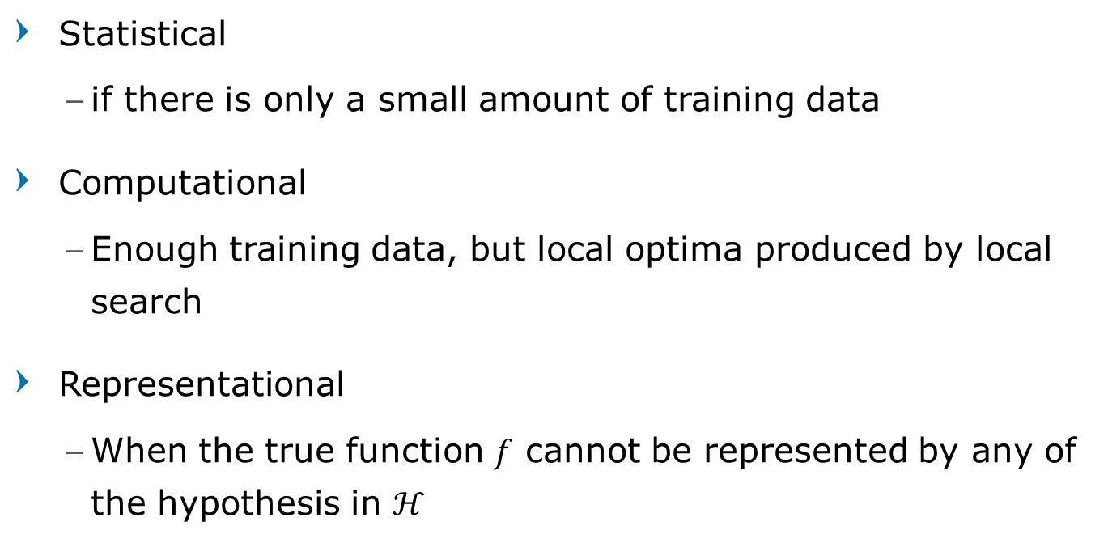
When to use Ensemble
Statistical
if there is only a small amount of training data
Computational
Enough training data, but local optima produced by local search
Representational
When the true function $f$ cannot be represented by any of the hypothesis in $ℋ$
Machine Learning

Slide 9
Why Ensemble Works
Suppose we have 5 completely independent classifiers for majority voting.
It means that for one test time, the decision is set based on either:
3 out of the 5 classifiers,
4 out of the 5 classifiers, or
all 5 classifiers
If each classifier has an accuracy of 70%, then what is the accuracy of the five combined methods?
Machine Learning

Slide 10
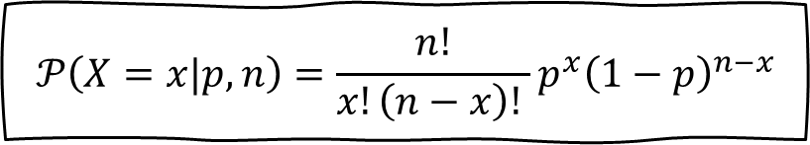
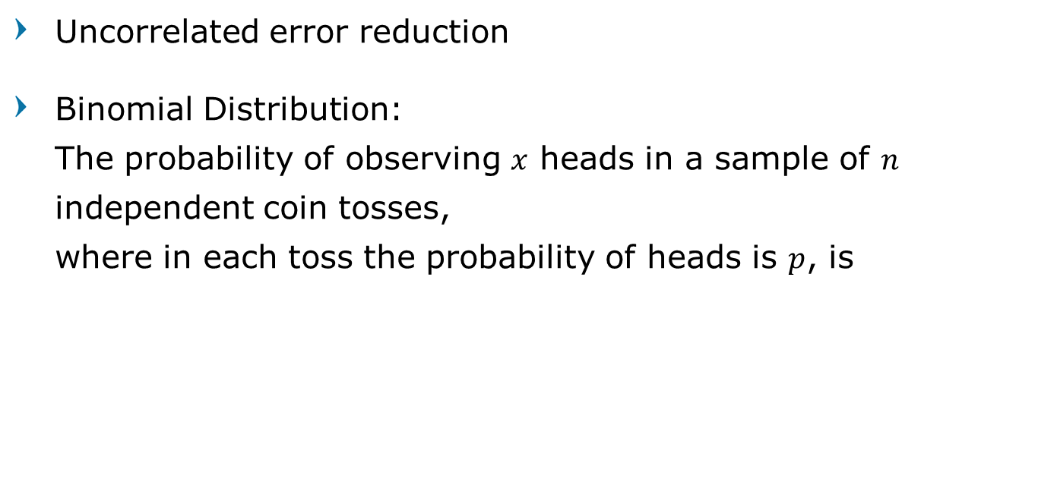
Why Ensemble Works
Uncorrelated error reduction
Binomial Distribution: The probability of observing $x$ heads in a sample of $n$ independent coin tosses, where in each toss the probability of heads is $p$, is
$$𝒫\left(X=x|p,n\right)=\frac{n!}{x!\left(n−x\right)! }p^{x}{\left(1−p\right)}^{n−x}$$
Machine Learning

Slide 11
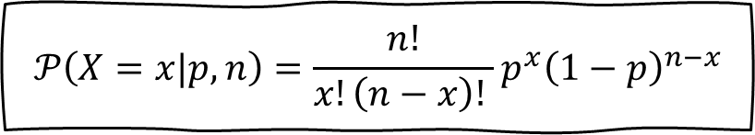
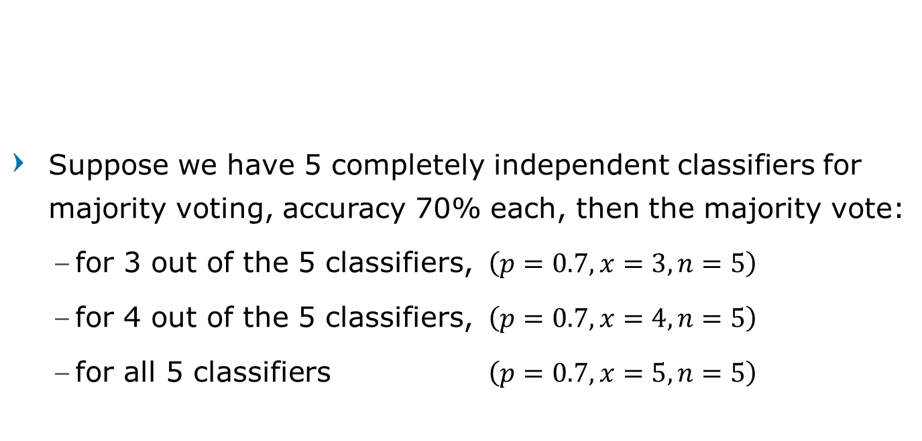
Why Ensemble Works
Suppose we have 5 completely independent classifiers for majority voting, accuracy 70% each, then the majority vote:
for 3 out of the 5 classifiers, $\left(p=0.7, x=3, n=5\right)$
for 4 out of the 5 classifiers, $\left(p=0.7, x=4, n=5\right)$
for all 5 classifiers $\left(p=0.7, x=5, n=5\right)$
$$𝒫\left(X=x|p,n\right)=\frac{n!}{x!\left(n−x\right)! }p^{x}{\left(1−p\right)}^{n−x}$$
Machine Learning

Slide 12
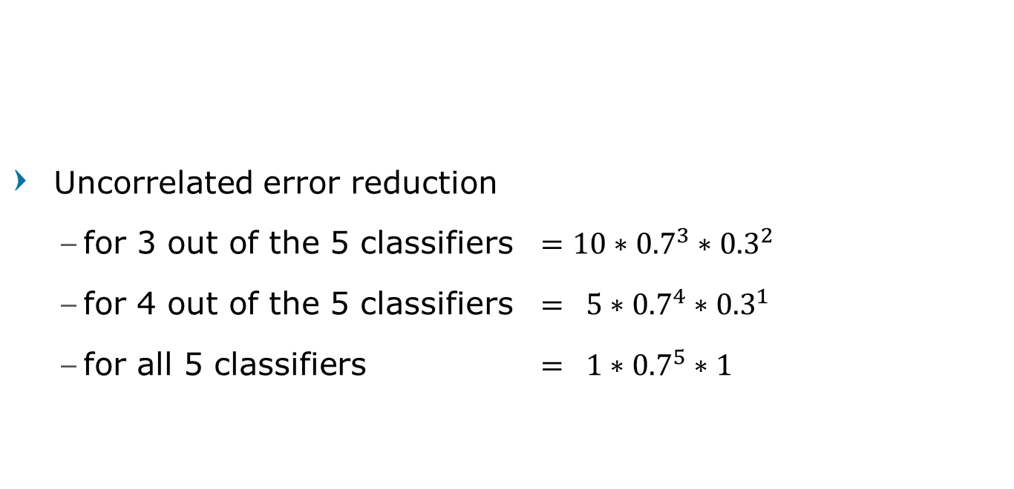
Why Ensemble Works
Uncorrelated error reduction
for 3 out of the 5 classifiers $=10∗{0.7}^{3}∗{0.3}^{2}$
for 4 out of the 5 classifiers $= 5∗{0.7}^{4}∗{0.3}^{1}$
for all 5 classifiers $= 1∗{0.7}^{5}∗1$
$$𝒫\left(X=x|p,n\right)=\frac{n!}{x!\left(n−x\right)! }p^{x}{\left(1−p\right)}^{n−x}$$
Machine Learning

Slide 13
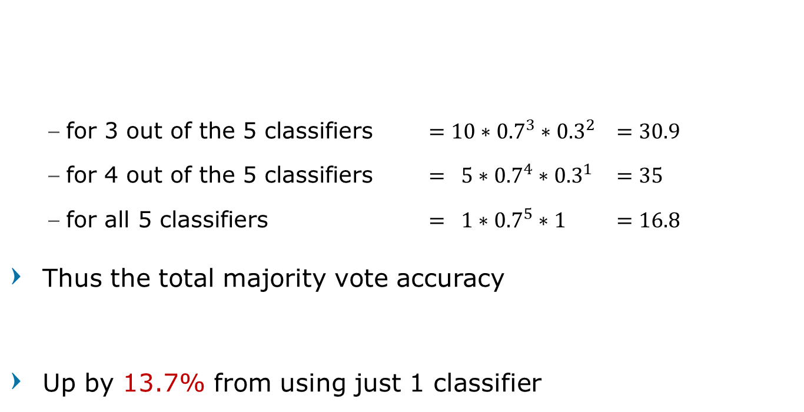

Why Ensemble Works
for 3 out of the 5 classifiers $=10∗{0.7}^{3}∗{0.3}^{2}$ $=30.9$
for 4 out of the 5 classifiers $= 5∗{0.7}^{4}∗{0.3}^{1}$ $=35$
for all 5 classifiers $= 1∗{0.7}^{5}∗1$ $=16.8$
Thus the total majority vote accuracy
Up by 13.7% from using just 1 classifier
$$𝒫\left(X=x|p,n\right)=\frac{n!}{x!\left(n−x\right)! }p^{x}{\left(1−p\right)}^{n−x}$$
$$30.9\%+35\%+16.8\%=83.7\%$$
Machine Learning

Slide 14
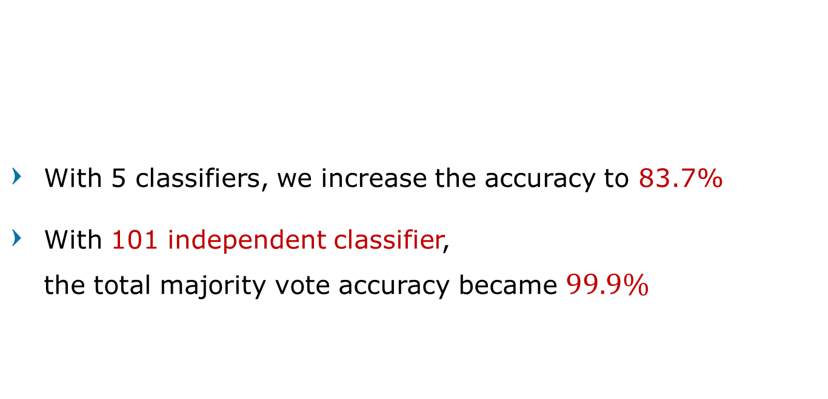
Why Ensemble Works
With 5 classifiers, we increase the accuracy to 83.7%
With 101 independent classifier, the total majority vote accuracy became $99.9\%$
$$𝒫\left(X=x|p,n\right)=\frac{n!}{x!\left(n−x\right)! }p^{x}{\left(1−p\right)}^{n−x}$$
Machine Learning

Slide 15
Maximizing accuracy and diversity
"No Free Lunch" Theorem
No single algorithm wins all the time
Different learners use different
Algorithms
Hyper-parameters
Representations / Modalities / Views
Training sets
Sub-problems
Machine Learning

Slide 16
Bias and Variance Error
Machine Learning

Slide 17
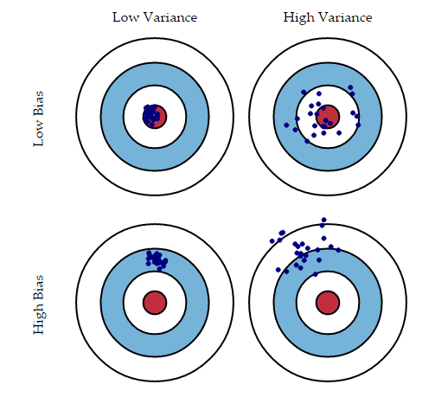
Bias and Variance
Prediction errors
to avoid the mistake of overfitting and underfitting
Monitor error training vs validation
Machine Learning

Slide 18
Bias Error
How far is the difference between prediction and target, on training data.
Model with high bias oversimplifies the model.
Machine Learning

Slide 19
Bias Error
How far is the difference between prediction and target, on training data.
Model with high bias oversimplifies the model.
Usually happen because the model is too simple, so it can not produce good predictions.
It leads to high error on both training and test data.
Machine Learning

Slide 20
Bias Error
Low bias
linear regression applied to linear data
2nd degree polynomial applied to quadratic data
ANN with many hidden units trained to completion
High bias
Using a constant function
linear regression applied to non-linear data
ANN with few hidden units applied to non-linear data
Machine Learning

Slide 21
Variance Error
The variability of model: How far is the difference between the predictions of the model formed from training dataset with other datasets.
Machine Learning

Slide 22
Variance Error
The variability of model: How far is the difference between the predictions of the model formed from training dataset with other datasets.
Usually happen because the model is too complex, so it is only suitable for current training data and does not generalize on the data which it hasn’t seen before.
Such models perform very well on training data but has high error rates on test data
Machine Learning

Slide 23
Variance Error
Low variance
constant function
model independent of training data
model depends on stable measures of data (mean or median)
High variance
high degree polynomial
ANN with many hidden units trained to completion
Machine Learning

Slide 24
Sources of Variance
noise in targets or input attributes
bias (model mismatch)
training sample
randomness in learning algorithm
neural net weight initialization
Randomized sub-setting of trainset:
cross validation, train and early stopping set
Machine Learning

Slide 25
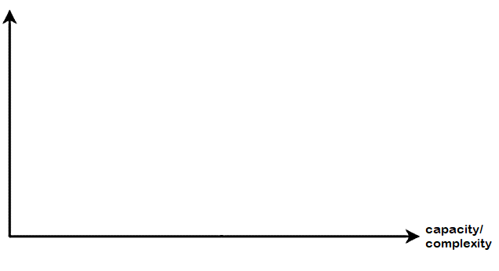
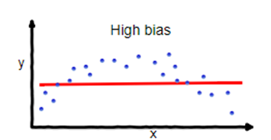
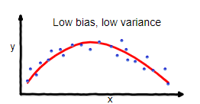
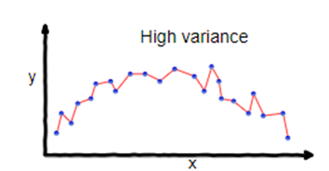
Bias vs Variance Trade-off
underfitting
overfitting
generalization error
generalization error
bias²
bias²
variance
variance
optimal capacity
Machine Learning

Slide 26
Bias vs Variance Trade-off
Testing Loss
generalization error
bias²
Training Loss
variance
Using training error and error testing to measure bias and variance
Machine Learning

Slide 27
Reduce Variance
The easiest way to reduce variance
Constant predictions, can only output 1 answer any input
Linear model even though the data is non-linear
Simple models can reduce variance, but can also increase bias
Machine Learning

Slide 28
Reduce Variance w/o Increasing Bias
Averaging reduces variance
So, Average models to reduce model variance !!
Problem :
Only one training set
Where do multiple models come from ?
BAGGING
Machine Learning

Slide 29
Bootstrap Aggregating
Machine Learning

Slide 30
Bootstrap
Create multiple sample sets/ datasets
Sampling with replacement
Contains around 63.2% original records in each sample
Machine Learning

Slide 31

Bootstrap
Training Data
Original Data
1
2
3
4
5
6
7
8
9
10
Bagging 1
2
5
5
7
8
8
9
10
10
10
Bagging 2
1
1
2
2
2
3
3
4
7
9
Bagging 3
1
3
5
5
5
6
7
8
9
10
Random select with replacement
$$…$$
Data sorted for better visualization
Machine Learning

Slide 32
Bootstrap Aggregating
Build a model on each bootstrap sample
Classification : Majority vote
Regression : Averaging score
Note:
the bagging examples are sorted orderly for better visualization,
but in the real implementation, left them shuffled/unordered
Machine Learning

Slide 33
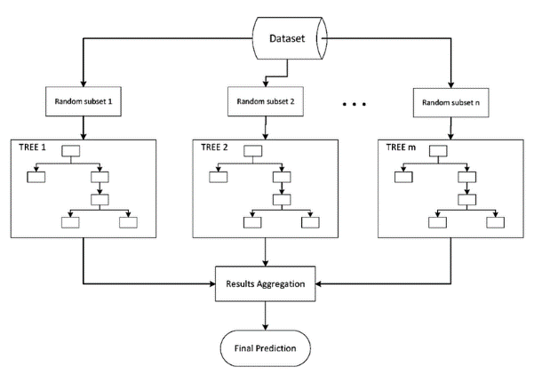
Bootstrap Aggregating
Machine Learning

Slide 34
Bootstrap Example
Machine Learning

Slide 35
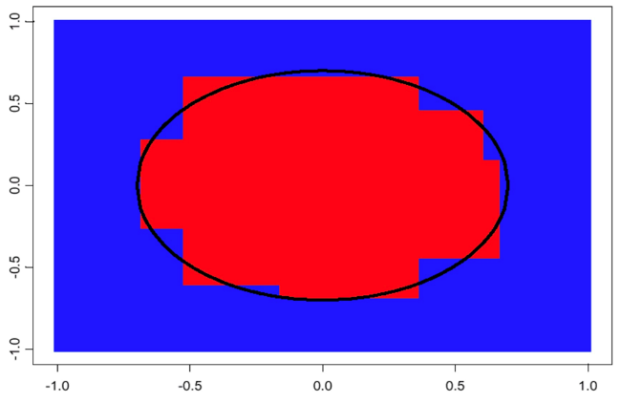
Prediction by 1 Decision Tree
Machine Learning

Slide 36
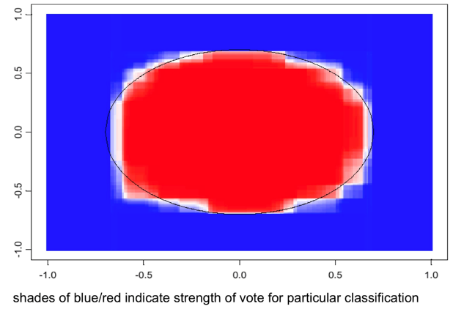
100 Bagged Tree
Machine Learning

Slide 37
Bagging Recap
Bagging reduces variance by averaging (reduce overfitting)
Bagging usually decreases MSE
Bagging has little effect on bias (or not at all)
Can we average and reduce bias?
BOOSTING
Machine Learning

Slide 38
Boosting
Machine Learning

Slide 39
Boosting
Principles
Boost a set of weak learners to a strong learner
Make records currently misclassified more important
Example
Train using all data
Test them
Turns out that Record 4 and 7 are wrongly classified
Training 1
Original Data |  | Original Data
1 | √ | 6 | √
2 | √ | 7 | X
3 | √ | 8 | √
4 | X | 9 | √
5 | √ | 10 | √
Machine Learning

Slide 40
Boosting
Its weight is increased; therefore it is more likely to be chosen
Training 1
Results
Continue Training
Training 2
Original Data |  | Original Data
1 | √ | 6 | √
2 | √ | 7 | X
3 | √ | 8 | √
4 | X | 9 | √
5 | √ | 10 | √
Original Data
2 | 7
3 | 7
3 | 8
4 | 9
6 | 10
Weighted sample
Test to All Data
Data sorted for better visualization
Machine Learning

Slide 41
Boosting
Its weight is increased; therefore it is more likely to be chosen
Training 2
Results
Continue Training
Training 3
Original Data |  | Original Data
1 | √ | 6 | √
2 | √ | 7 | √
3 | √ | 8 | √
4 | X | 9 | √
5 | X | 10 | √
Original Data
1 | 2
2 | 5
4 | 5
4 | 7
4 | 9
Weighted sample
Test to All Data
Data sorted for better visualization
Machine Learning

Slide 42

Boosting
Its weight is increased; therefore it is more likely to be chosen
Training 3
Results
Continue Training
Training 4
Original Data |  | Original Data
1 | √ | 6 | √
2 | √ | 7 | √
3 | √ | 8 | √
4 | X | 9 | √
5 | √ | 10 | √
Original Data
4 | 3
4 | 5
4 | 6
4 | 8
4 | 10
Weighted sample
$$…$$
Data sorted for better visualization
Machine Learning

Slide 43
AdaBoost
Initially, set uniform weights on all the records
At each round
Create a bootstrap sample based on the weights
Train a classifier on the sample and apply it on the original training set
Records that are wrongly classified will have their weights increased
Records that are classified correctly will have their weights decreased
If the error rate is higher than 50%, start over
Final prediction is weighted average of all the classifiers with weight representing the training accuracy
Machine Learning

Slide 44
AdaBoost
Machine Learning

Slide 45
Boosting Recap
Advantages
Very little code
Reduces variance
Disadvantages
Sensitive to noise and outliers.
Machine Learning

Slide 46
Ensemble Recap
Machine Learning

Slide 47
Bagging vs Boosting
Bagging:
Combine by consensus
Parallel ensemble, each model is built independently
aim to decrease variance, not bias
Boosting:
Combine by learning
Sequential ensemble, try to add new models that do well where previous models lack
aim to decrease bias
Machine Learning

Slide 48
Bagging vs Boosting
Bagging:
suitable for high variance low bias models (complex models)
an example of a tree-based method is random forest, which develop fully grown trees (note that RF modifies the grown procedure to reduce the correlation between trees)
Boosting: suitable for low variance high bias models
an example of a tree-based method is gradient boosting
Machine Learning

Slide 49
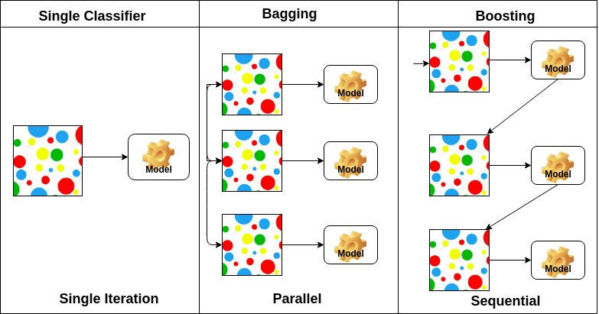
Ensemble Recap
Machine Learning

Slide 50
Question?
Machine Learning

